Slide 1
Linear Regression-Elantra Sales Prediction
By Atanu Das

Slide 2
REGRESSION CONCEPT:
Regression analysis is a predictive modelling technique that analyzes the relation between the target or dependent variable(Y) and one or more independent variables(X1,X2,..,Xn) in a dataset. The relationship can be linear or non-linear. The dependent variable is also known as explained variable and independent variable is also known as explanatory variable. Regression analysis involves determining the best fit line, which is a line that passes through all the data points in such a way that distance of the line from each data point is minimized.
Mathematical Relationship is an exact relationship
Y=β0+β1X
Statistical Relationship is not an exact relationship
Y=β0+β1X+e
(This is a population regression function)
The types of regression techniques in Machine Learning are:
Linear Regression
Logistic Regression
Ridge Regression
Lasso Regression
Polynomial Regression
Bayesian Linear Regression

Slide 3
DATASET AND TASK:
About The Data: In this problem, we will try to predict monthly sales of the Hyundai Elantra in the United States. The Hyundai Motor Company is a major automobile manufacturer based in South Korea. The Elantra is a car model that has been produced by Hyundai since 1990 and is sold all over the world, including the United States.
Each observation is a month, from January 2010 to February 2014. For each month, we have the following variables:
• Month = the month of the year for the observation (1 = January, 2 = February, 3 = March, ...).
• Year = the year of the observation.
• ElantraSales = the number of units of the Hyundai Elantra sold in the United States in the given month.
• Unemployment = the estimated unemployment percentage in the United States in the given month.
• Queries = a (normalized) approximation of the number of Google searches for "hyundai elantra" in the given month.
• CPI_energy = the monthly consumer price index (CPI) for energy for the given month.
• CPI_all = the consumer price index (CPI) for all products for the given month; this is a measure of the magnitude of the prices paid by consumer households for goods and services (e.g., food, clothing, electricity, etc.).
The dataset consist of 50 rows.

Slide 4

TASK: The task is to explore the factors which have an impact on the monthly sales of the elantra car by using an Machine Learning Technique.
I will perform the task with the help of Linear Regression Technique

Slide 5
LINEAR REGRESSION: CONCEPT
Linear regression is one of the most basic types of regression in machine learning. Linear regression is used for finding linear relationship between target and one or more predictors. The linear regression model consists of a predictor variable and a dependent variable related linearly to each other. In case the data involves more than one independent variable, then linear regression is called multiple linear regression models.
Types of Linear Regression
• Simple Linear Regression: Y=B0 +B1 X + e
• Multiple Linear Regression: Y=B0 +B1 X + B2 X1 + B3 X2 + .......+ Bk Xk +e
Interpretation of the coefficients of the above equation:
Y=Dependent variable
B0=Population Y intercept. It is the mean value of the dependent variable Y, when the independent variable X=0
Bi=Population Slope. It is the change in the value of the dependent variable, Y, for unit change in the independent variable Xi, keeping all other Xs constant (controlled).
e=Random error

Slide 6
LINEAR REGRESSION : CONCEPT
MULTIPLE LINEAR REGRESSION :ASSUMPTIONS
Linear regression needs the relationship between the independent and dependent variables to be linear.
Normality-The errors should be normally distributed.
Homoscedasticity-At each level of predictor variable, the variance of residual term should be constant.
Multicollinearity-There should be no perfect relationship i.e. no explanatory variable should be highly correlated. One such way to check multicollinearity is with the help Variance Inflation Factor(VIF).VIF is a relative increase in variance in S.E(Standard Error) of beta caused by collinearity.
Auto correlation-For any two observations of dependent variable, the error terms should not be correlated. Error term should always follow random distribution. It shouldn’t follow any pattern. One way to check auto-correlation is with the help of Durbin Watson Test(DW).DW value ranges from 0-4.At DW=2,it is considered that no autocorrelation exists.

Slide 7
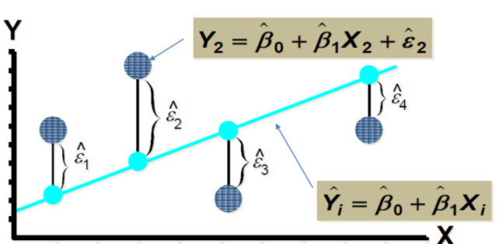
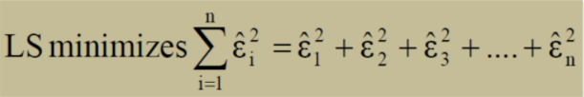
LINEAR REGRESSION MODEL METHODOLOGY-OLS
Multiple Linear Regression model follows the ordinary least square method. Ordinary least squares, or linear least squares, estimates the parameters in a regression model by minimizing the sum of the squared residuals. This method draws a line through the data points that minimizes the sum of the squared differences between the observed values and the corresponding fitted values.

Slide 8
PROBLEM STATEMENT:
Build an analytical model to predict monthly sales of the Hyundai Elantra in the United States.
Questions:
Load the data set. Split the data set into training and testing sets as follows: place all observations for 2012 and earlier in the training set, and all observations for 2013 and 2014 into the testing set. How many observations are in the training set?
We have splitted the dataset based on the condition as mentioned in the question into training and testing sets. Training dataset has 36 observations and testing dataset has 14 observations.
2. Build a linear regression model to predict monthly Elantra sales using Unemployment, CPI_all, CPI_energy and Queries as the independent variables. Use all of the training set data to do this. What is the model R-squared?
We have build a linear regression model to predict monthly Elantra sales using Unemployment, CPI_all, CPI_energy and Queries as the independent variables using training dataset. The summary of the linear regression model is as shown in the figure below

Slide 9
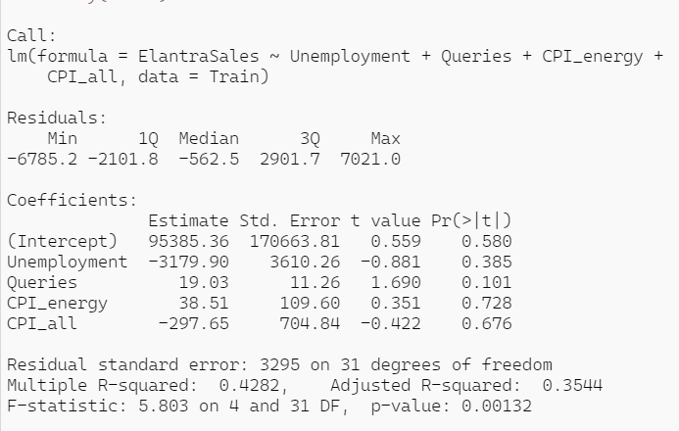
PROBLEM STATEMENT:
Multiple R-Squared of this model is 0.4282.

Slide 10
PROBLEM STATEMENT:
3. How many variables are significant, or have levels that are significant? Use 0.10 as your p-value cutoff.
At p-value 0.10 none of the variables are significant or have levels that are significant.
4. What is the coefficient of the Unemployment variable? What is the interpretation of this coefficient?
The coefficient of the Unemployment variable is -3179.90
The interpretation of this coefficient is:
For an increase in 1 unit of Unemployment, the prediction of Elantra sales decreases by 3179.90 unit.
5.In our problem, since our data includes the month of the year in which the units were sold, it is feasible for us to incorporate monthly seasonality. From a modeling point of view, it may be reasonable that the month plays an effect in how many Elantra units are sold.To incorporate the seasonal effect due to the month, build a new linear regression model that predicts monthly Elantra sales using Month as well as Unemployment, CPI_all, CPI_energy and Queries. Do not modify the training and testing data frames before building the model. What is the model R-Squared?

Slide 11
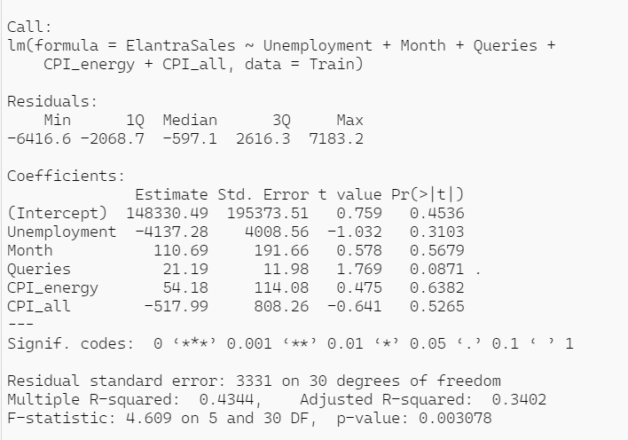
PROBLEM STATEMENT:
R-square of the previous model was relatively low so in order to improve our model we have re-run the linear regression model by taking month into consideration along with the other variables. The summary of the linear regression model is given below:
Multiple R-squared for this new model is 0.4344 but value of Adjusted R-squared has gone down to 0.3402 from 0.3544 and none of the variables are very significant. The adjusted R-Squared is the R-Squared but adjusted to take into account the number of variables. If the adjusted R-Squared is lower, then this indicates that our model is not better and in fact may be worse. Furthermore, if none of the variables have become significant, then this also indicates that the model is not better.

Slide 12
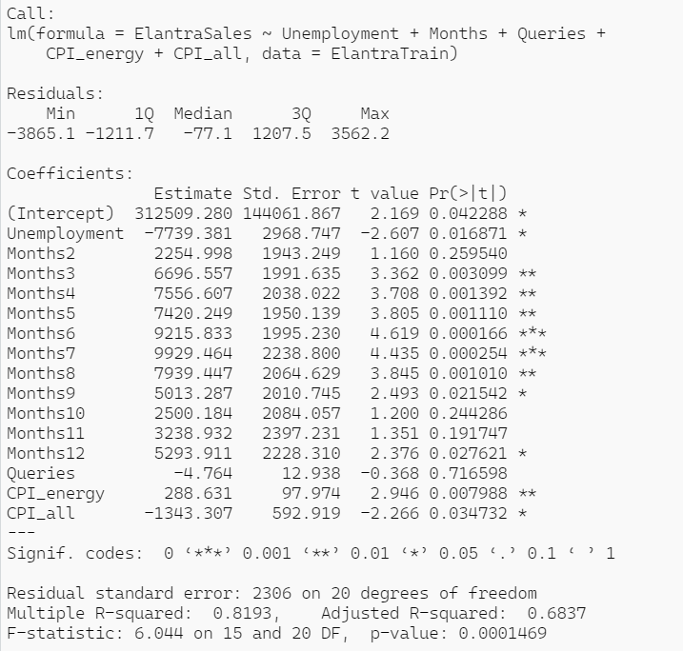
PROBLEM STATEMENT:
6.Re-run the regression with the Month variable modeled as a factor variable. What is the model R-Squared?
If we can look back our second model and dataset we can see that we are predicting sales based on Month that takes integer value, however it should be a factor variable. So, first we are going to convert this variable into factor variable. Now again we re-run the model by taking month as factor variable and the summary of the model is given. R-squared of this model is 0.8193 and adjusted R-squared is 0.6837.

Slide 13
PROBLEM STATEMENT:
7.Which variables are significant, or have levels that are significant? Use 0.10 as your p-value cutoff. (Select all that apply.)
We can see that at p-value of 0.1 Unemployment, Months, CPI_energy and CPI_all are significant whereas none of the variables were very much significant in the previous models. Another peculiar observation about the regression is that the sign of the Queries variable has changed. In particular, when we naively modeled Month as a numeric variable, Queries had a positive coefficient. Now, Queries has a negative coefficient. Furthermore, CPI_energy has a positive coefficient. If the price of energy increases, we would expect consumers to have less funds to purchase automobiles, leading to lower Elantra sales. The changes in coefficient signs and signs that are counter to our intuition may be due to a multicolinearity problem. To check, we will compute the correlations of the variables in the training set.

Slide 14
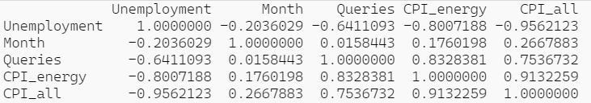
PROBLEM STATEMENT:
CORRELATION OF THE VARIABLES
From the correlation table we can see that there are many variables highly correlated (Unemployment, CPI_energy, CPI_all) with each other; as a result, the sign change of Queries is likely to be due to multicolinearity.

Slide 15
PROBLEM STATEMENT:
REDUCING THE MODEL
Now we will simplify the model using the factor version of the Month variable. We will do this by iteratively removing variables, one at a time. First we will remove the variable with the highest p-value (i.e., the least statistically significant variable) from the model. we will continue to repeat this until there are no variables that are insignificant or variables for which all of the factor levels are insignificant. We are going to use a threshold of 0.10 to determine whether a variable is significant.
From the last model we saw that queries possess the highest p-value. We re-run the model after removing the queries and the summary which we obtained is as follows:

Slide 16
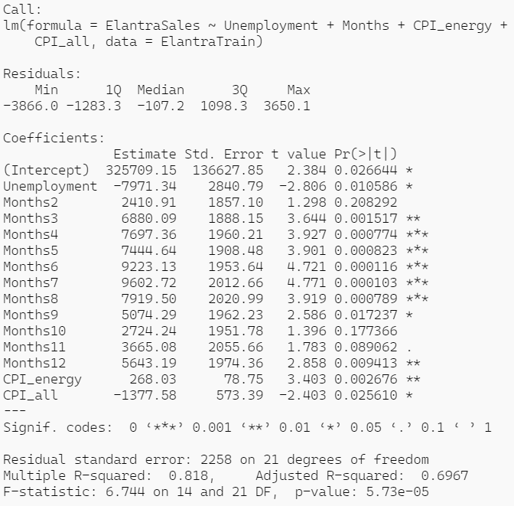
PROBLEM STATEMENT:
Multiple R-squared for this model is 0.818 and adjusted R-squared is 0.6967.We can see from the summary that there are no variables that are insignificant, at the 0.10 p-level. Note that Month has a few values that are insignificant, but we don’t want to remove it because many values are very significant. So, we don't need to go for another iteration by removing a variable.

Slide 17
PROBLEM STATEMENT:
8.Using the model from train data set (best fit), make predictions on the test set. What is the sum of squared errors of the model on the test set?
The sum of the squared errors of the model on the test set is 190757747.
What is the test set R-Squared?
The test set R-Squared is 0.7280232
10. What is the largest absolute error that we make in our test set predictions? In which period (Month, Year pair) do we make the largest absolute error in our prediction?
The largest absolute error that we make in our test set predictions is 7491.488.
The month year pair with the largest absolute error is (3,2013)

Slide 18
FINAL SIGNIFICANT VARIABLES
The final significant variables which have an impact on the Elantra sales are as follows:
Unemployment
Months2
Months3
Months4
Months5
Months6
Months7
Months8
Months9
Months10
Months11
Months12
CPI_energy
CPI_all
Among these independent variables only Unemployment and CPI_all has negative impact on sales. Rest all have positive impact.

Slide 19
THANK YOU

